Slide 1
Music Instrument Classification
Selected Topics in Music and Acoustic Engineering – Final Project

Slide 2
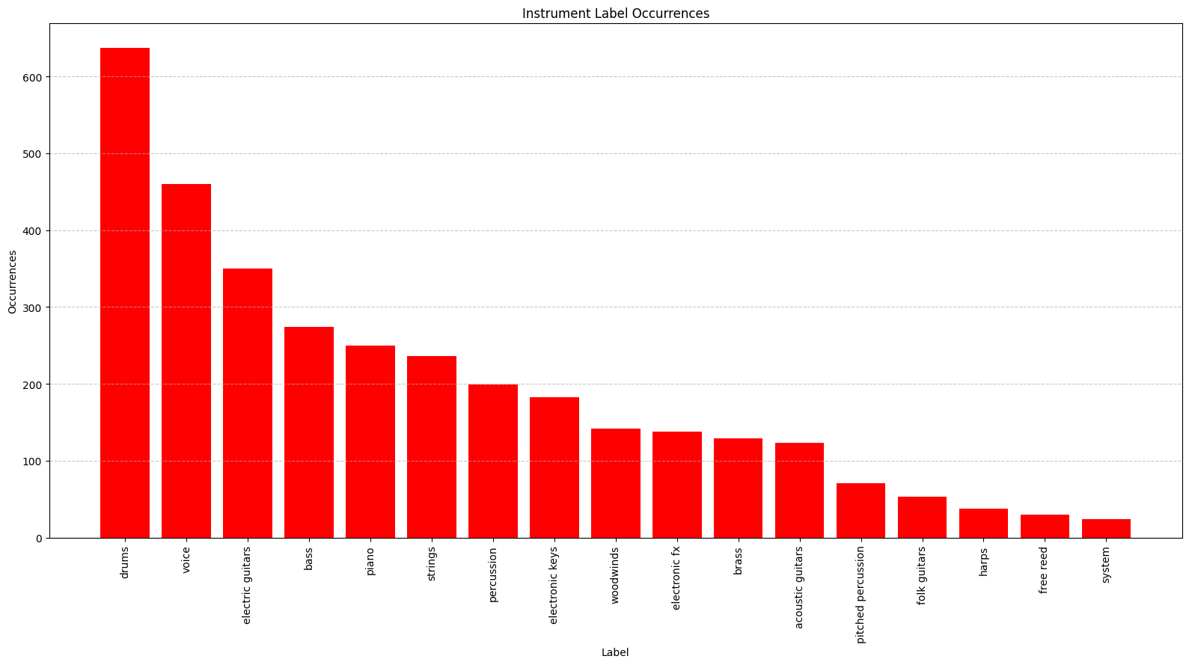
Dataset structure & preparation
MedleyDB 1.0 (196 tracks)
MedleyDB 1.0 (92 classes)
Simplified DB (17 classes)
MIX FILE
(SONG)
Male voice
Voice
Female voice
Violin
Strings
STEM 1
(Piano)
STEM 2
(Male Singer)
STEM 3
(Electric bass)
STEM 4
(Drum set)
Viola
Cello
Erhu
RAW
1.1
RAW
1.2
RAW
1.3
RAW
2.1
RAW
2.2
RAW
2.3
RAW
3.1
RAW
3.2
RAW
3.3
RAW
4.1
RAW
4.2
RAW
4.3
Piano
Piano
Tack piano
Original label
Binarized label
Voice
0, 1, 0
Strings, Voice, Piano
1, 1, 1
Strings, Piano
1, 0, 1

Slide 3
Dataset structure & preparation
Overview
MedleyDB 1.0 (196 tracks)
MIX FILE
(SONG)
STEM 1
(Piano)
STEM 2
(Male Singer)
STEM 3
(Electric bass)
STEM 4
(Drum set)
RAW
1.1
RAW
1.2
RAW
1.3
RAW
2.1
RAW
2.2
RAW
2.3
RAW
3.1
RAW
3.2
RAW
3.3
RAW
4.1
RAW
4.2
RAW
4.3

Slide 4
Dataset structure & preparation
Label simplification through macrocategories
MedleyDB 1.0 (92 classes)
Simplified DB (17 classes)
Male voice
Voice
Female voice
Violin
Strings
Viola
Cello
Erhu
Piano
Piano
Tack piano

Slide 5
Dataset structure & preparation
Multilabel binarization and DataFrame construction
Original label
Binarized label
Voice
0, 1, 0
Strings, Voice, Piano
1, 1, 1
Strings, Piano
1, 0, 1

Slide 6
Dataset structure & preparation
Summary

Slide 7
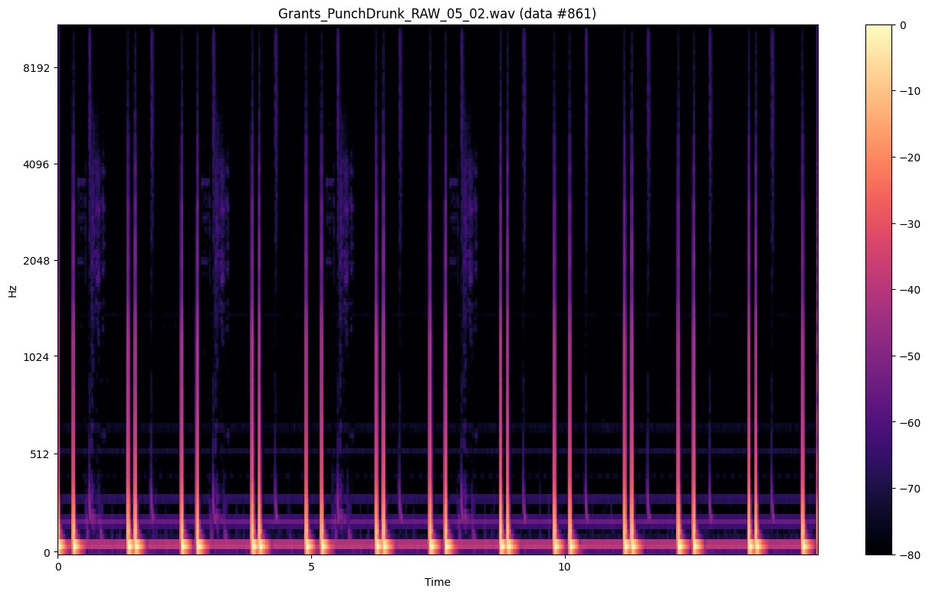
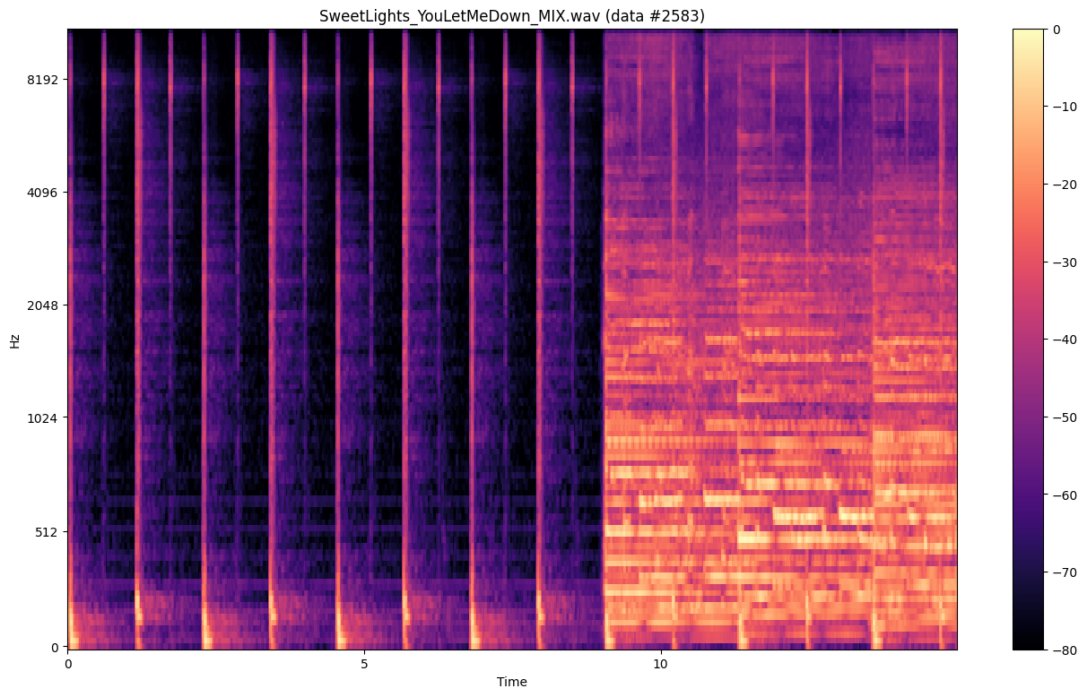
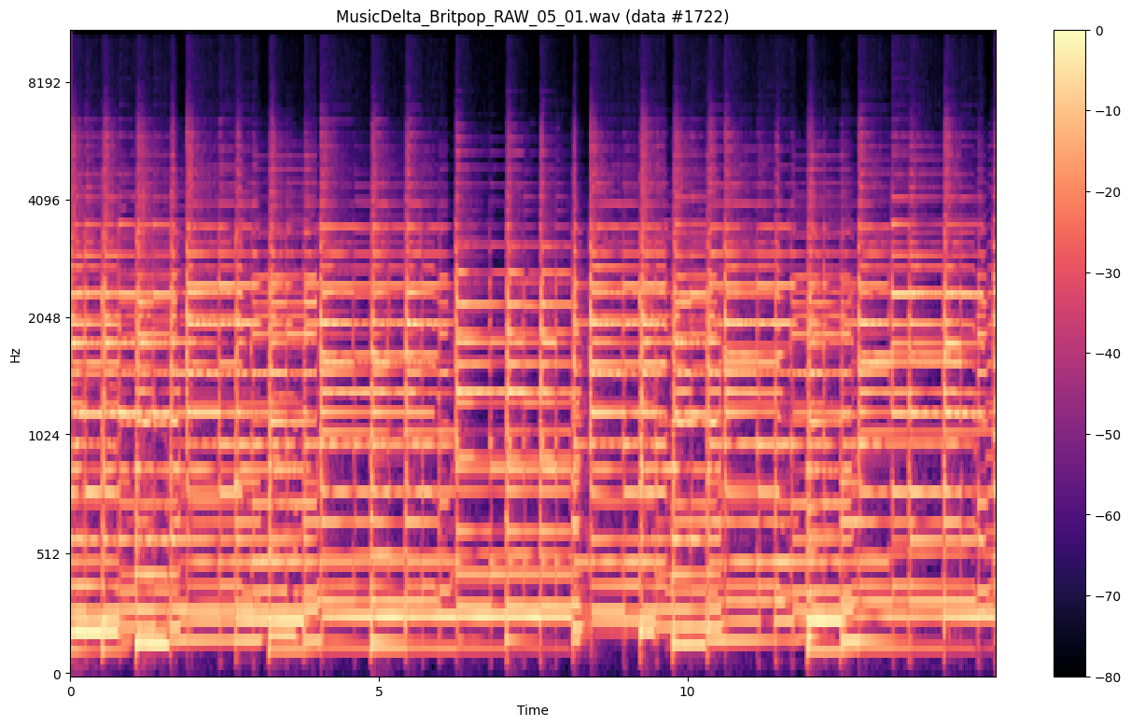
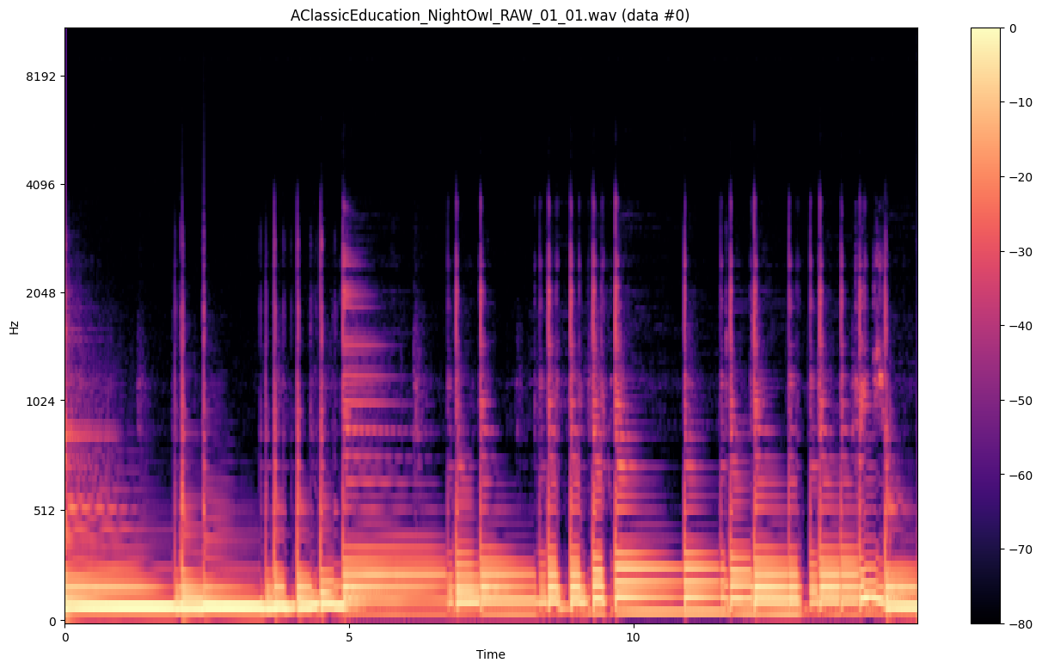
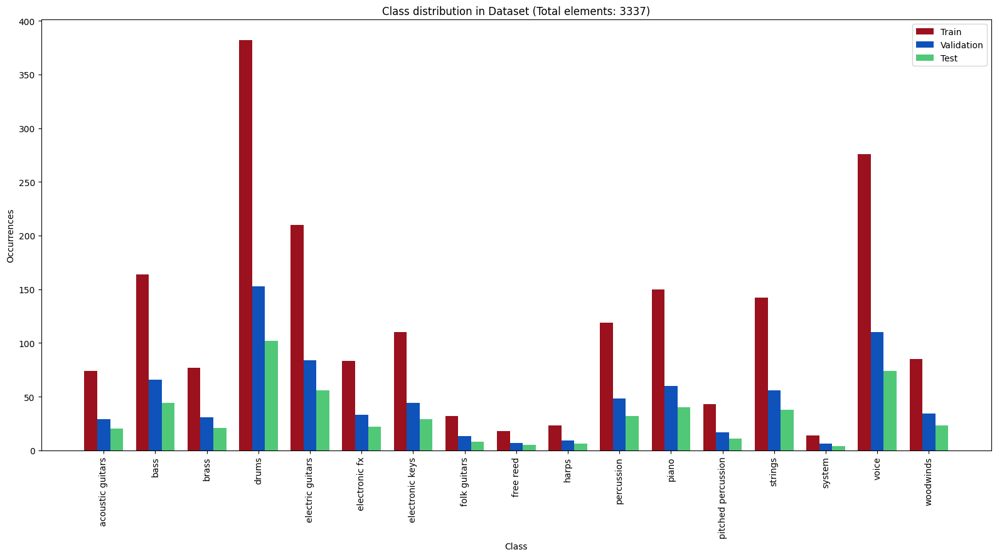
Audio feature extraction & data preparation
Suggested starting index
Piano
Voice
Strings
15 s
Dataset partition
Train set augmentation
Train (60%)
Time stretch
Pitch Shift
Validate (24%)
Test (16%)

Slide 8
Audio feature extraction & data preparation
Audio extraction & segmentation
Suggested starting index
Piano
Strings
Voice
15 s

Slide 9
Audio feature extraction & data preparation
Mel-spectrogram computation

Slide 10
Audio feature extraction & data preparation
Dataset splitting
Dataset partition
Train (60%)
Validate (24%)
Test (16%)

Slide 11
Audio feature extraction & data preparation
Data augmentation and balancing
Train set augmentation
Time stretch
Pitch Shift

Slide 12
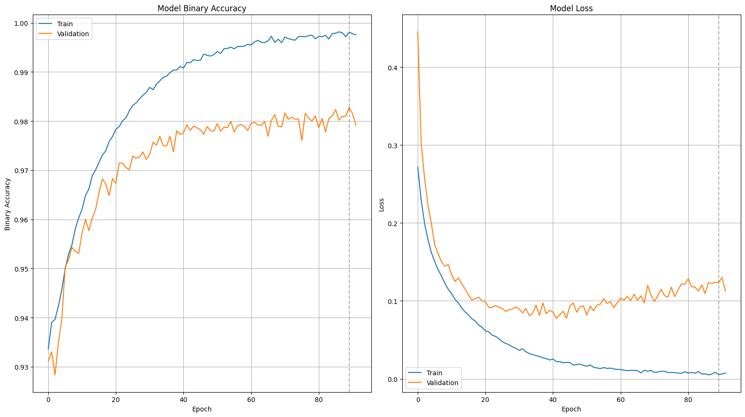
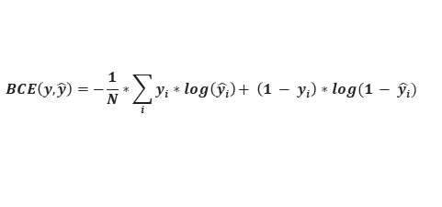
Model architecture & training strategy
Model design
Metrics
Conv2D
MaxPooling2D
Dropout
DATA
Conv2D
MaxPooling2D
Dropout
Convolutional blocks
$$Binary Accuracy=\frac{True Positives+True Negatives}{True Positives+False Positives+True Negatives+False Negatives}$$
Conv2D
MaxPooling2D
Dropout
$$BCE\left(y,\hat{y}\right)=−\frac{1}{N}∗\sum_{i}{y_{i}∗log\left(\hat{y_{i}}\right)+ \left(1 − y_{i}\right)∗log(1 − \hat{y_{i}})}$$
GlobalAveragePooling2D
OUTPUT
Metrics
Train & val set test results
CSVLogger
Patience reached?
EarlyStopping
[50 epochs]
MODEL
STOP
ModelCheckpoint
Max epochs?

Slide 13
Model architecture & training strategy
Convolutional neural network design
Model design
Conv2D
MaxPooling2D
Dropout
DATA
Conv2D
MaxPooling2D
Dropout
Convolutional blocks
Conv2D
MaxPooling2D
Dropout
GlobalAveragePooling2D
OUTPUT

Slide 14
Model architecture & training strategy
Compilation and optimization
Metrics
$$Binary Accuracy=\frac{True Positives+True Negatives}{True Positives+False Positives+True Negatives+False Negatives}$$
$$BCE\left(y,\hat{y}\right)=−\frac{1}{N}∗\sum_{i}{y_{i}∗log\left(\hat{y_{i}}\right)+ \left(1 - y_{i}\right)∗log(1 - \hat{y_{i}})}$$

Slide 15
Model architecture & training strategy
Callbacks, regularization & training procedure
Metrics
CSVLogger
Patience reached?
EarlyStopping
[50 epochs]
MODEL
STOP
Max epochs?
ModelCheckpoint

Slide 16
Model architecture & training strategy
Results
Train & val set test results

Slide 17
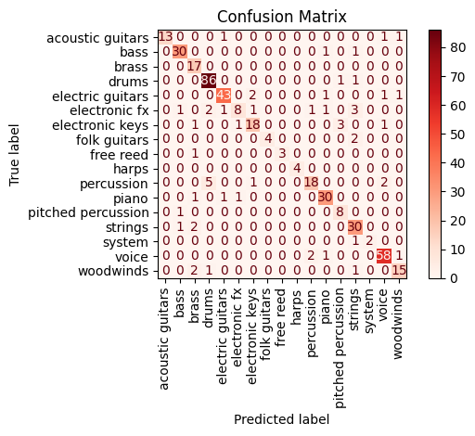
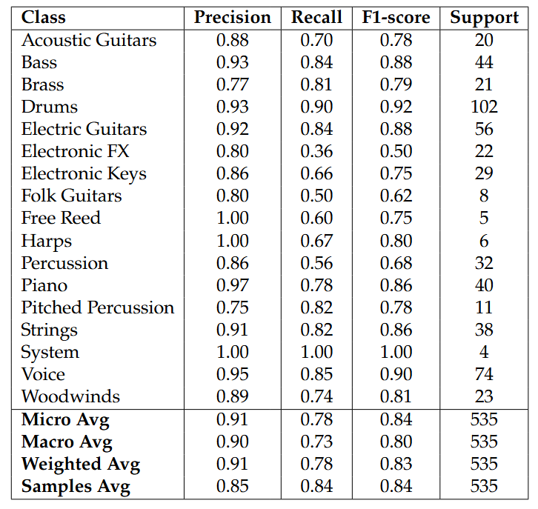
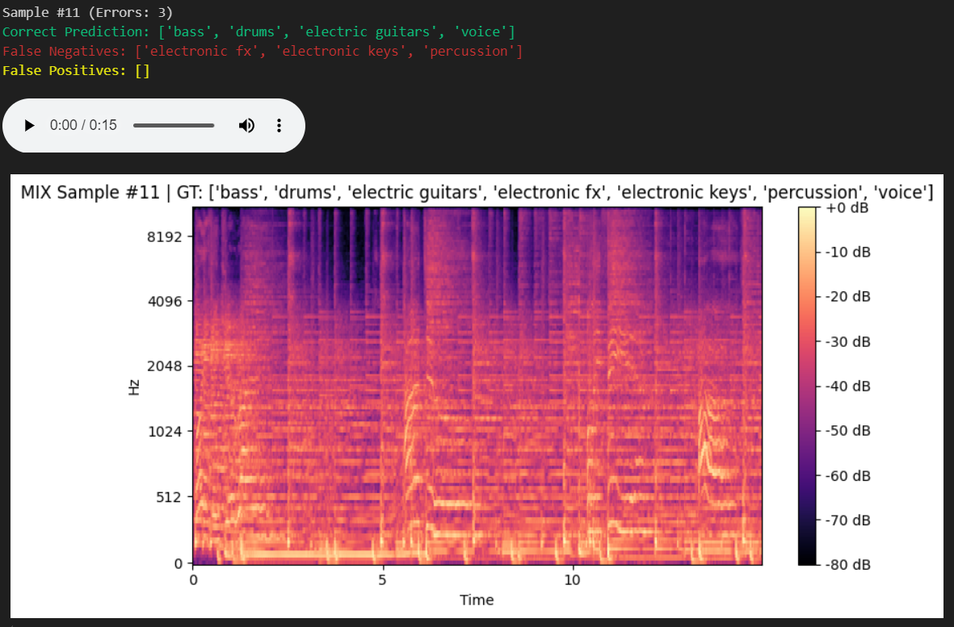
Model evaluation & analysis
Confusion matrix
Classification report
Mix prediction example

Slide 18
Model evaluation & analysis
Confusion matrix analysis for unique instruments
Confusion matrix

Slide 19
Model evaluation & analysis
Performance on mix samples
Mix prediction example

Slide 20
Model evaluation & analysis
General view over model performance
Classification report

Slide 21
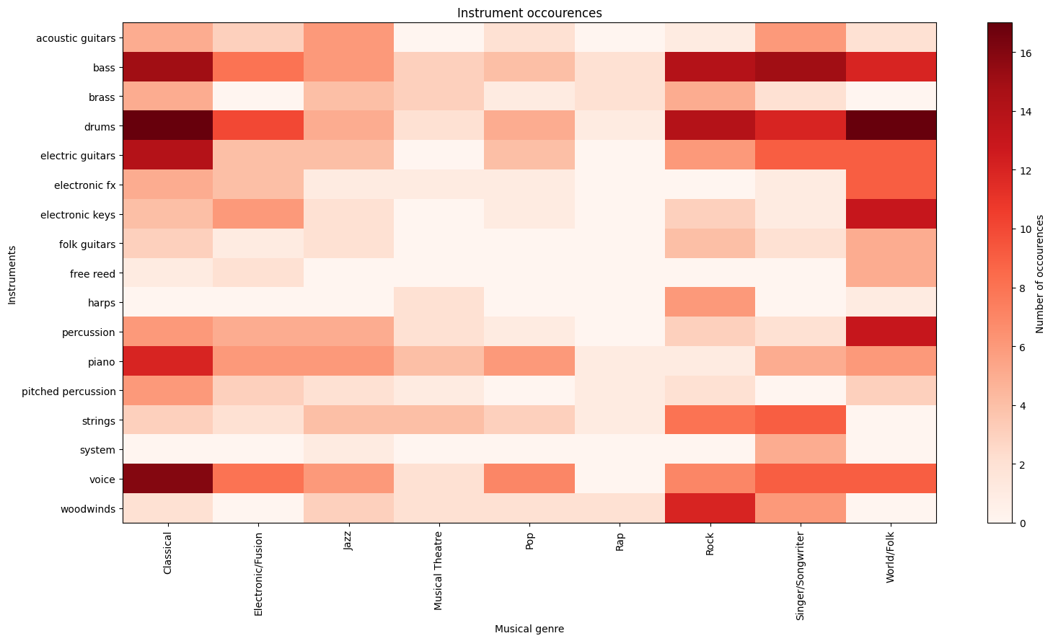
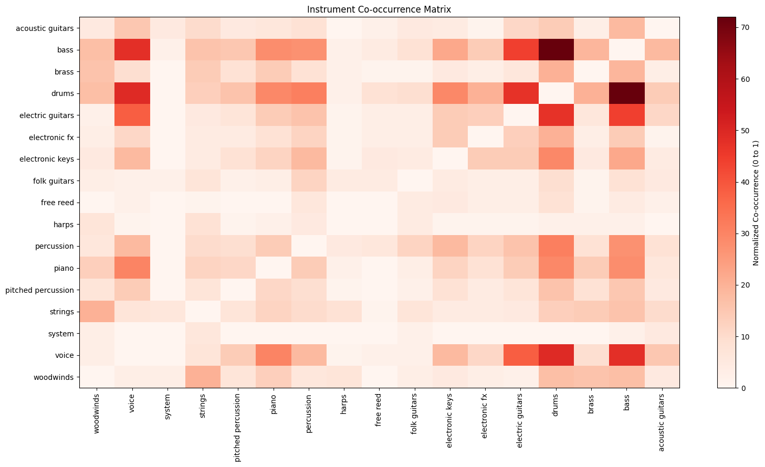
Genre & instrument occurrence analysis
I-G occurrences workflow
I-G Occurrences (ML)
Genre
DataSet
DataFrame
Instrument occurrences per genre
Songs
Instruments
Ins Co-occurrences workflow
Instr Co-occurrences (ML)
Columns
DataSet
Instrument co-occurrence matrix
Songs
Instruments
Rows

Slide 22
Genre & instrument occurrence analysis
Instrument-genre occurrences DataFrame workflow
I-G occurrences workflow
Genre
DataSet
DataFrame
Instrument occurrences per genre
Songs
Instruments

Slide 23
Genre & instrument occurrence analysis
Instrument-genre occurrences using instrument macro-labels
I-G Occurrences (ML)

Slide 24
Genre & instrument occurrence analysis
Instrument co-occurrence matrix workflow
Ins Co-occurrences workflow
Columns
DataSet
Instrument co-occurrence matrix
Songs
Instruments
Rows

Slide 25
Genre & instrument occurrence analysis
Instrument co-occurrence using instrument macro-labels
Instr Co-occurrences (ML)

